Slide 1

IE 260 – ENGINEERING ECONOMY Chapter 2 Cost Concepts and Design Economics
U. MAHİR YILDIRIM

Slide 2
Chapter 2
The objective of Chapter 2 is to analyze short-term alternatives when the time value of money is not a factor.
We accomplish this with three types of problems:
economic breakeven analysis;
cost-driven design optimization; and
present economy studies.

Slide 3
Cost Concepts
Fixed / Variable Costs
If costs change appreciably with fluctuations in business activity, they are “variable.” Otherwise, they are “fixed.”
Some examples of fixed costs
Insurance, taxes on facilities, administrative salaries, rental payments and initial setup or installation.
Some examples of variable costs
Direct labor, direct material, unit transportation.
A widely used cost model is: Total Costs = ?
Fixed Costs + Variable Costs

Slide 4
Example Surfacing a new highway
In connection with surfacing a new highway, a contractor has a choice of two sites on which to set up the mixing plant equipment.
The contractor estimates that it will cost $1.15 per cubic meter per kilometer to haul the asphalt paving material from the mixing plant to the job site.
If site B is selected, there will be an added charge of $96 per day for a flagman.
The job requires 50,000 cubic meters of mixed asphalt paving material. It is estimated that four months (17 weeks of five working days per week) will be required for the job.

Slide 5

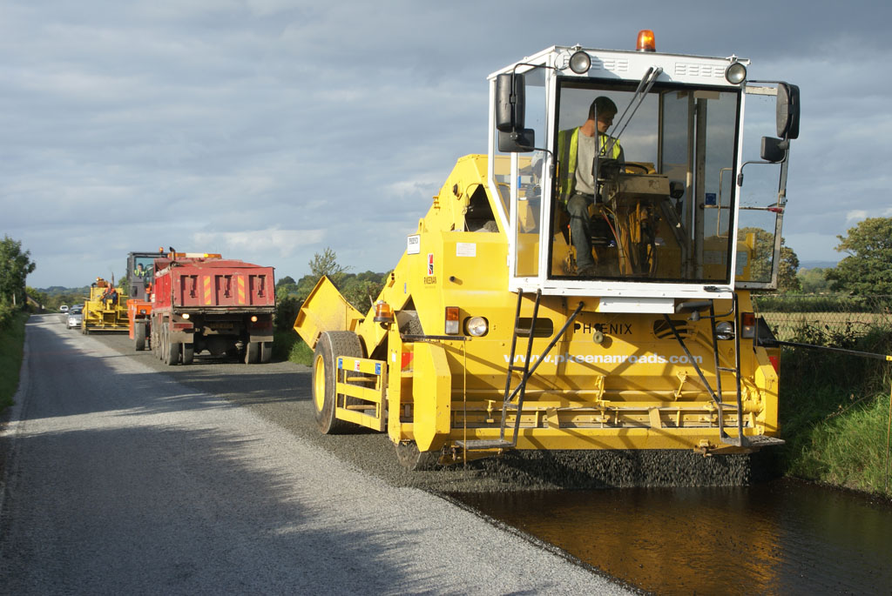
Example (cont’d) Surfacing a new highway

Slide 6
Example (cont’d) Surfacing a new highway
Compare the two sites in terms of their fixed, variable, and total costs.
For the selected site, how much profit can be made if $8.05 is paid per cubic meter delivered to the job site?
Cost Factors | Site A | Site B
Average hauling distance | 6 km | 4.3 km
Monthly rental of site | $ 1,000 | $ 5,000
Cost to setup and remove equipment | $ 15,000 | $ 25,000
Hauling expense | $ 1.15 / m³ / km | $ 1.15 / m³ / km

Slide 7
Solution (a) Surfacing a new highway
Fixed Costs | Site A | Site B
Monthly rental of site | $1,000 x 4 | $5,000 x 4
Cost to setup and remove equipment | $15,000 | $25,000
Flagman Wage | 0 | $96 x 85
Total Fixed Costs | $19,000 | $53,160
Variable Costs | Site A | Site B
Hauling Expense | $ 1.15 / m³ / km x 6 km x 50,000 m³ = $345,000 | $ 1.15 / m³ / km x 4.3 km x 50,000 m³ = $247,250
Total Costs | Site A | Site B
Fixed + Variable | $364,000 | $300,410

Slide 8
Solution (b) Surfacing a new highway
Profit = Revenue – Total Cost
Revenue = $8.05 / m³ x (50,000 m³) = $402,500
Profit = $402,500 – $300,410 = $102,090

Slide 9
Cost Concepts (cont’d)
Overhead Costs - All costs of providing goods or services other than direct labor and direct material. Indirect costs are a subset of overhead costs. Fixed overhead relates more to plant capacity than production volume (variable overhead). Allocation of overhead to specific outputs may be in proportion to: – Direct labor hours – Direct material costs – Machine hours
Cash Cost - Involves an actual cash payment.
Book Cost - Reflected only in the accounting system
Depreciation

Slide 10
Cost Concepts (cont’d)
Sunk Cost - Past costs that are unrecoverable and are not relevant for decision making purposes. Sunk costs are nonrefundable cash outlays such as money spent on a passport.
Suppose the heating, ventilating and air conditioning (HVAC) system in your home has just experienced a major failure. You immediately call the Air Comfort Company for an estimate to replace your system. Their price is $4,200 and you gladly sign a contract and write a check for the required $1,000 down payment.
At this point the weather warms and the urgency for replacement of your defunct system eases somewhat.
You then get a second estimate for a new HVAC system. It is $3,000. You call Air Comfort back and they inform you that the $1,000 down payment is not refundable! What should you do?

Slide 11
Cost Concepts (cont’d)
Opportunity Cost - The cost of forgoing the chance to earn interest (or profit) on investment funds. • Consider a student who could earn $20,000 for working during a year but chooses instead to go to school for a year and spend $5,000 to do so. The opportunity cost of going to school for that year is $25,000: $5,000 cash outlay and $20,000 for income foregone.(Neglects the influence of income taxes and assumes that the student has no earning capability while in school)
Life Cycle Cost (LCC) - LCC are a summation of all the costs (and some revenues) over the entire life span of a product, structure, or system. All amounts are expressed in dollars that are time equivalent (the subject of Chapter 4).
General Formula: LCC = Investment Costs + O&M Costs + Replacement Costs + Energy Costs + Disposal Costs – Salvage Value (if any)

Slide 12
Outline
This lecture will introduce some of these basic economic concepts and indicate how they may be factors for consideration in engineering studies and managerial decisions
The General Price-Demand Relationship
The Total Revenue Function
Breakeven Analysis
Profit Function
Optimal Production Quantity

Slide 13
Consumer and Producer Goods and Services
Consumer Goods and Services
Producer Goods and Services
Products or services that are directly used by people to satisfy their wants.
Products or services that are re used to produce consumer goods and services or other producer goods.
food,
clothing,
cars,
haircuts,
opera,
medical services
machine tools,
factory buildings,
farm machinery

Slide 14
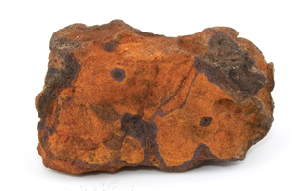
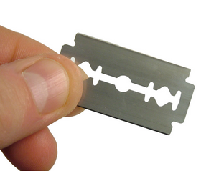
Measures of Economic Worth
Goods and services are produced and desired because they have utility
Much of our business activity, including engineering, focuses on increasing the utility (value) of materials and products by changing their form or location
processed, combined with suitable alloying elements
iron ore
worth only a few dollars per ton
significantly increases in value

Slide 15
Necessities & Luxuries
Car ?
These terms are relative, because, for most goods and services, what one person considers a necessity may be considered a luxury by another

Slide 16


The General Price-Demand Relationship
For all goods and services, there is a relationship between the price that must be paid and the quantity that will be demanded or purchased.
p
$$\text{0 ≤} \text{D} \text{≤}\frac{a}{b},a>0, b>0$$
a: base (maximum) price (intercept on the price axis)
$$p=a−bD$$
Price
b: the amount by which demand increases for each unit decrease in p.
(-b is the slope )
D
Units of Demand
Notes:
As the selling price per unit (p) is increased, there will be less demand (D) for the product, and as the selling price is decreased, the demand will increase.

Slide 17
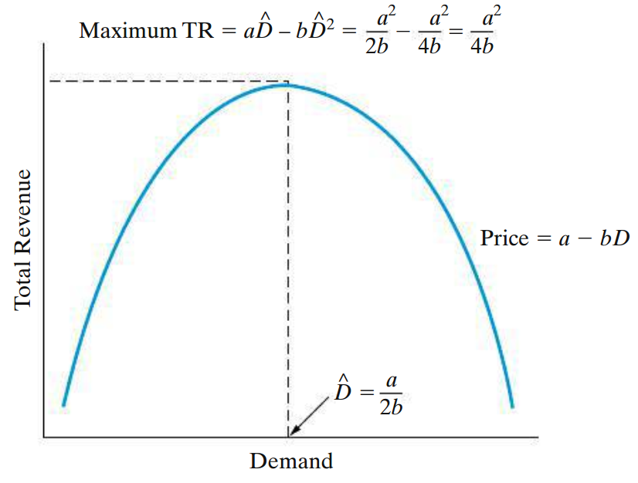

The Total Revenue Function
?
TR = price × demand = $p · D$
TR = $\left(a−bD\right)D$ = $aD−bD^{2}$
?

Slide 18
Breakeven Analysis
Notation
TR = Total Revenue CT = Total Cost CF = Fixed Cost CV = Variable Cost v = Unit Variable Cost per unit p = Price per unit D = Demand (output rate)
Scenario1 - When the price per unit (p) for a product or service can be represented as being independent of demand and is greater than the variable cost per unit (v), a single breakeven point results.

Slide 19
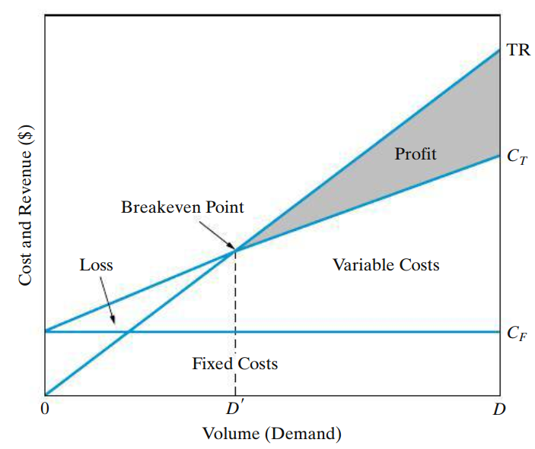









Breakeven Analysis Scenario 1
$$CT=CF+CV$$
$$TR$$
$$CV=v.D$$
Profit
$$TR=p.D$$
$$CT$$
Breakeven Point
Cost and Revenue ($)
Loss
Variable Costs
$$CF$$
Fixed Costs
$$D′$$
$$D$$
Volume (Demand)

Slide 20
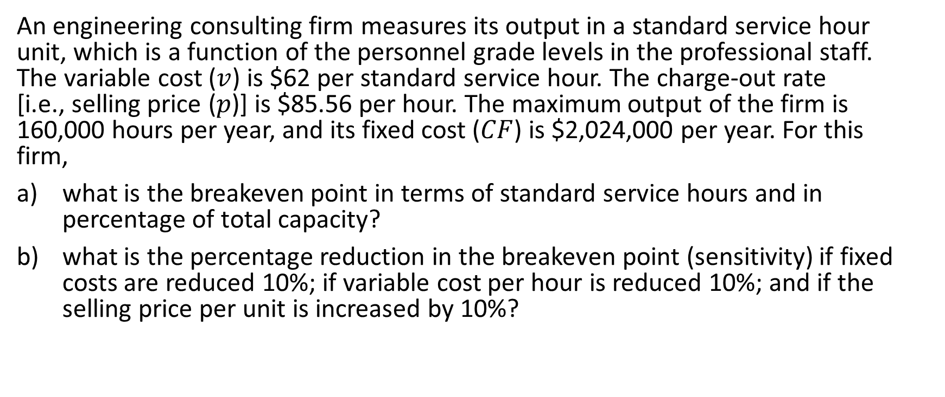
Example 1 Breakeven Analysis – Scenario 1
An engineering consulting firm measures its output in a standard service hour unit, which is a function of the personnel grade levels in the professional staff. The variable cost ($v$) is $62 per standard service hour. The charge-out rate [i.e., selling price ($p$)] is $85.56 per hour. The maximum output of the firm is 160,000 hours per year, and its fixed cost ($CF$) is $2,024,000 per year. For this firm,
what is the breakeven point in terms of standard service hours and in percentage of total capacity?
what is the percentage reduction in the breakeven point (sensitivity) if fixed costs are reduced 10%; if variable cost per hour is reduced 10%; and if the selling price per unit is increased by 10%?

Slide 21
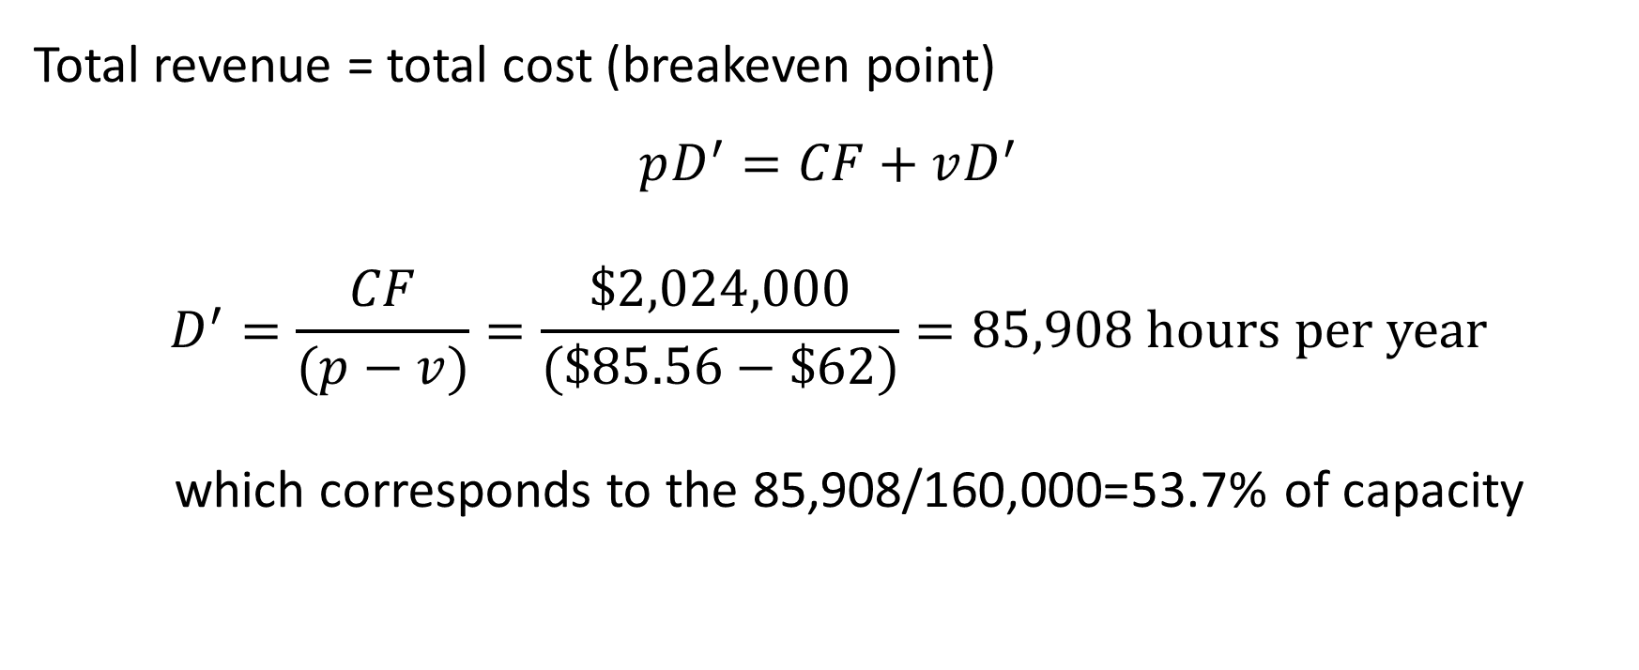
Solution 1 - a Breakeven Analysis – Scenario 1
Total revenue = total cost (breakeven point) $$pD^{′}=CF+vD^{′}$$
$$D^{′}=\frac{CF}{(p−v)}=\frac{\$2,024,000}{(\$85.56−\$62)}=85,908 hours per year$$
which corresponds to the 85,908/160,000=53.7% of capacity

Slide 22
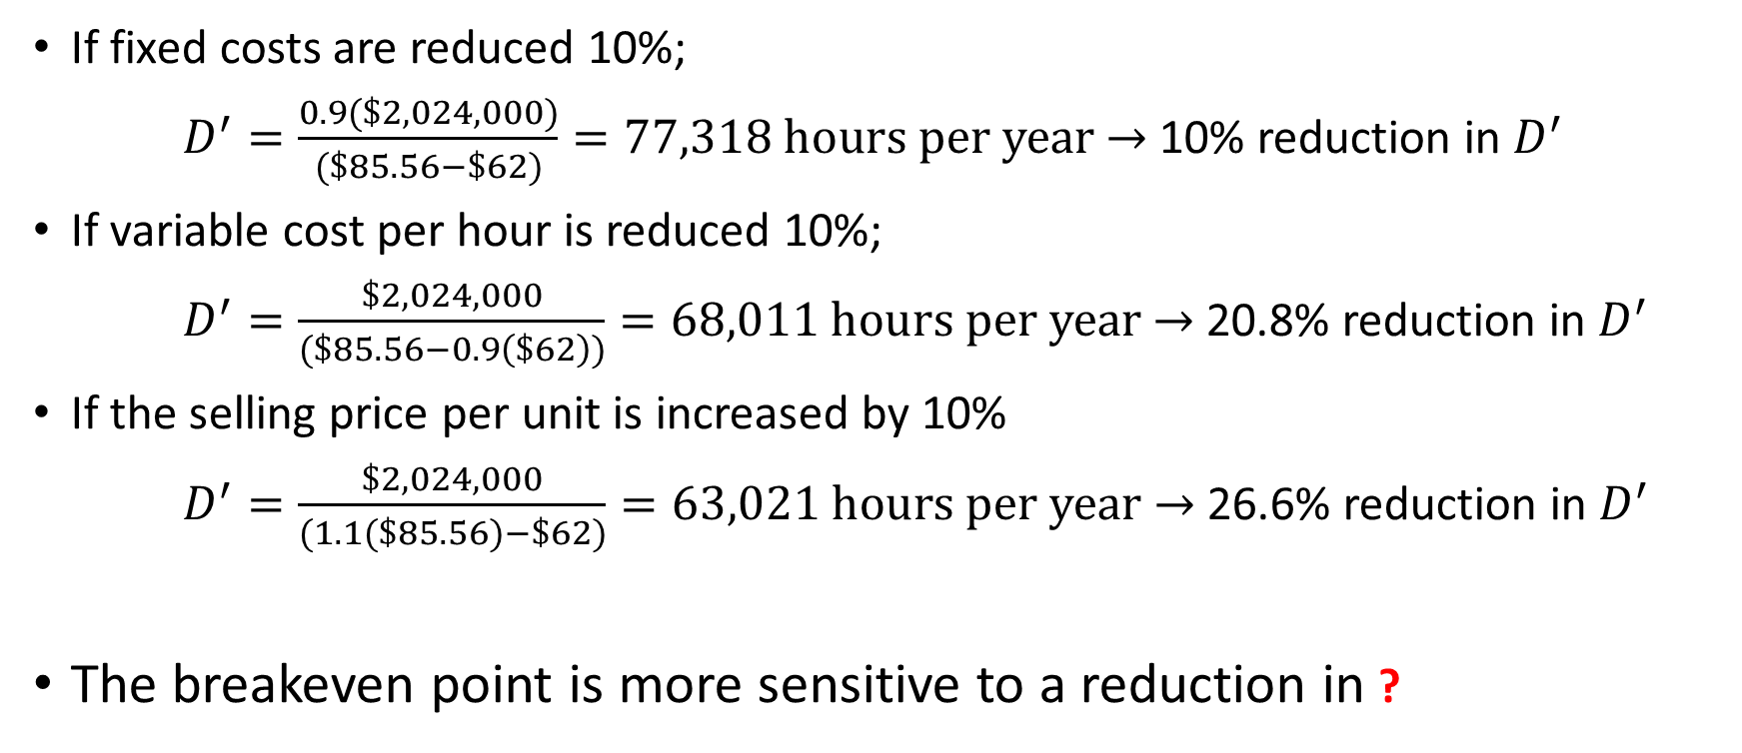
Solution 1 - b Breakeven Analysis – Scenario 1
If fixed costs are reduced 10%;
$D^{′}=\frac{0.9(\$2,024,000)}{(\$85.56−\$62)}=77,318 hours per year$ $→$ 10% reduction in $D^{′}$
If variable cost per hour is reduced 10%;
$D^{′}=\frac{\$2,024,000}{(\$85.56−0.9\left(\$62\right))}=68,011 hours per year$ $→$ 20.8% reduction in $D^{′}$
If the selling price per unit is increased by 10%
$D^{′}=\frac{\$2,024,000}{(1.1(\$85.56)−\$62)}=63,021 hours per year$ $→$ 26.6% reduction in $D^{′}$
The breakeven point is more sensitive to a reduction in ?

Slide 23

Example 2 Breakeven Analysis – Scenario 1
At UMY Restaurant, which sells only pepperoni pizza, the monthly expenses are as follows;
How many pizzas does UMY Restaurant need to sell at $10 each to cover all those fixed and variable monthly expenses?
or
What is the breakeven point in terms of pizzas?
Fixed Costs |  |  | Variable Costs
General Labor | $1,500 |  | Flour | $0.44
Rent | $3,000 |  | Yeast | $0.05
Insurance | $200 |  | Water | $0.01
Advertising | $515 |  | Cheese | $3.00
Utitilies | $500 |  | Pepperoni | $2.00
Total | $5,715 |  | Total | $5.50

Slide 24

Solution 2 Breakeven Analysis – Scenario 1
Total revenue = total cost (at breakeven point) $pD^{′}= CF + vD^{′}$
$\$10D^{′}=\$5715+\$5.5D^{′}$
breakeven point = $D^{′}$ = 1270 pizzas

Slide 25
Example 3 Breakeven Analysis – Scenario 1
Consider the Surfacing a new highway example in which the following costs are related to two alternatives, site A and site B. What is the BREAKEVEN quantity of mixed asphalt at which SITES A and B are indifferent?
Costs | Site A | Site B
Fixed Cost | $19,000 | $53,160
Variable Cost | $6.9/m³ | $4.95/m³

Slide 26
Solution 3 Breakeven Analysis – Scenario 1
BREAKEVEN ANALYSIS for the LEAST COST alternative
650,000
Site A is the
Site B is the
LEAST COST alternative
LEAST COST alternative
CT(A)
CT(B)
CT(B)-CT(A)
400,000
?
?
Cost ($)
150,000
-100,000
17,518
Quantity of mixed asphalt (m³)

Slide 27
Example 4 Breakeven Analysis – Scenario 1
Three project alternatives are considered as an investment opportunity, their cost figures are provided in the following table
Calculate the breakeven point for each pair of alternatives.
Show their cost comparison on a graph.
For the expected output rate of 10,000 units in the considered period, which alternative would you prefer? And what is the selling price per unit to make $10,000 profit in that period?
Costs | A | B | C
Fixed Cost | $100,000 | $120,000 | $150,000
Variable Cost ($/unit) | 15 | 12 | 10

Slide 28
Solution 4 Breakeven Analysis – Scenario 1
450,000
CT(A)
CT(B)
CT(C)
Cost ($)
250,000
The LEAST COST alternative is A
The LEAST COST alternative is B
The LEAST COST alternative is C
0
0
6,667
10,000
15,000
Quantity of output (units)

Slide 29
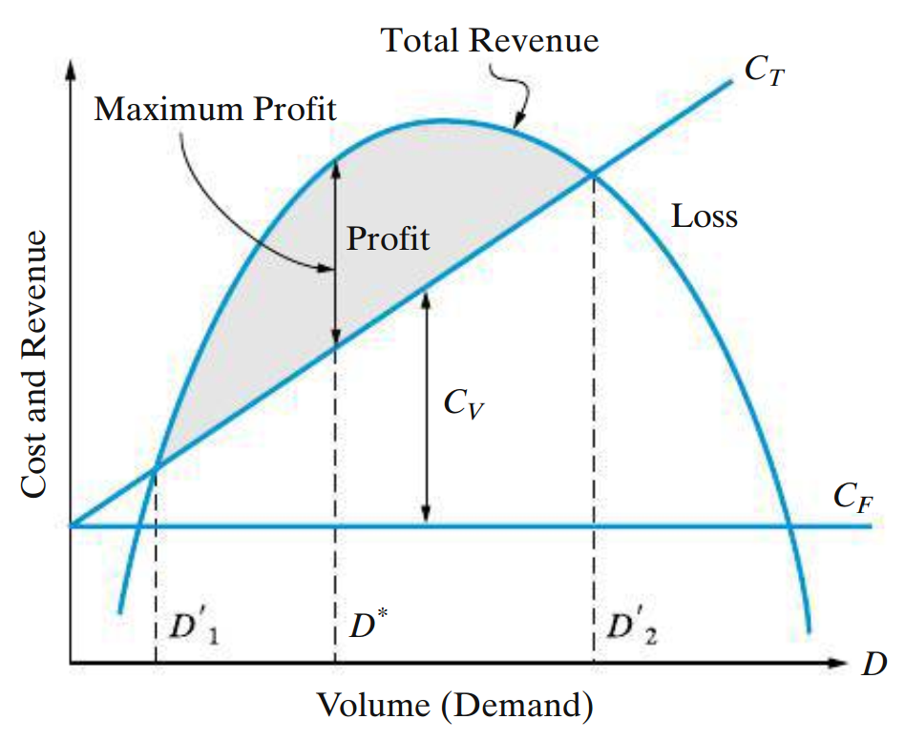
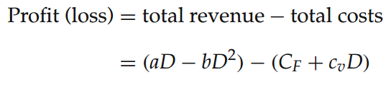



Breakeven Analysis Scenario 2
Demand is a function of price

Slide 30


Breakeven Analysis (cont’d) Scenario 2
The optimal value of D that maximizes profit is
To ensure that we have maximized profit (rather than minimized it), the sign of the second derivative must be negative. Checking this, we find that
which will be negative for b > 0 (as specified earlier).

Slide 31



Breakeven Analysis (cont’d) Scenario 2
Total revenue = total cost (breakeven point)
This is a quadratic equation with one unknown (D), so we can solve for the breakeven points D′₁ and D′₂ (the roots of the equation):

Slide 32
Example 5 Breakeven Analysis – Scenario 2
A company produces an electronic timing switch that is used in consumer and commercial products. The fixed cost (CF) is $73,000 per month, and the variable cost (v) is $83 per unit. The selling price per unit is p = $180 - 0.02(D). For this situation,
determine the optimal volume for this product and confirm that a profit occurs (instead of a loss) at this demand.
find the volumes at which breakeven occurs; that is, what is the range of profitable demand?

Slide 33
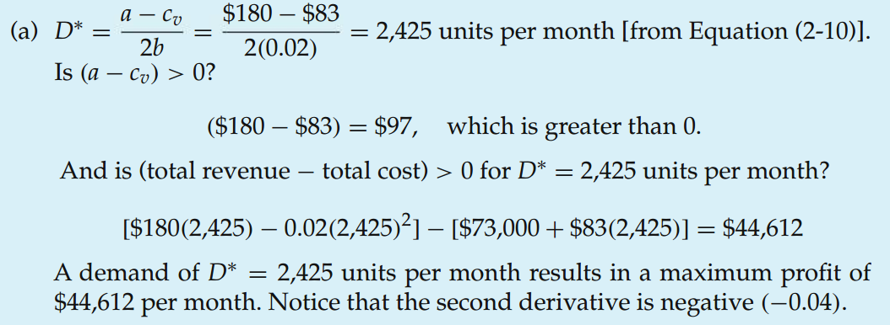

Solution 5 - a Breakeven Analysis – Scenario 2

Slide 34
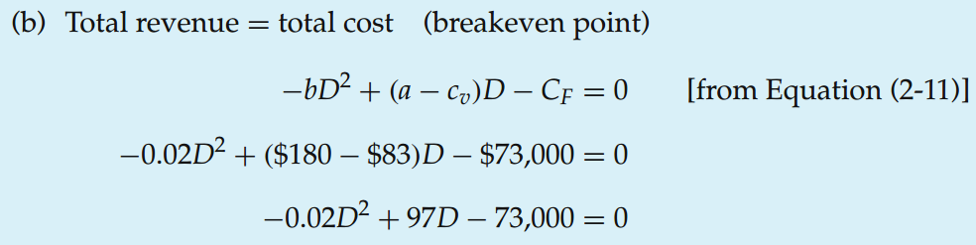

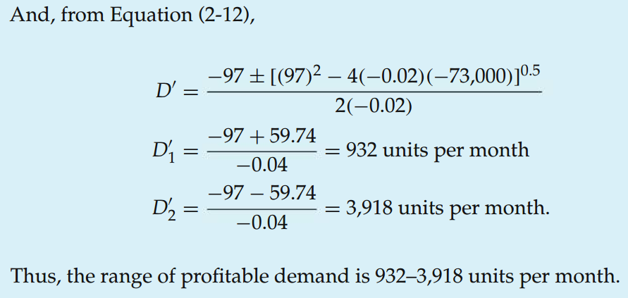

Solution 5 - b Breakeven Analysis – Scenario 2

Slide 35
End of Chapter 2

